Slide 1
PEDIATRIC TOXICOLOGY
Feb 2026

Slide 2
No financial disclosures

Slide 3
Recognize common pediatric toxidromes and high risk ingestions including "one pill can kill" exposures
Discuss age-appropriate stabilization and management of pediatric toxicology/poisonings
Discuss differences between adult and pediatric toxicologic emergencies

Slide 4
February 2026

Slide 5

Epidemiology
Poison control calls: 42% calls kids <5yo
Kids
  Large BSA
  Higher RR/minute ventilation
  Smaller weights

Slide 6
February 2026

Slide 7

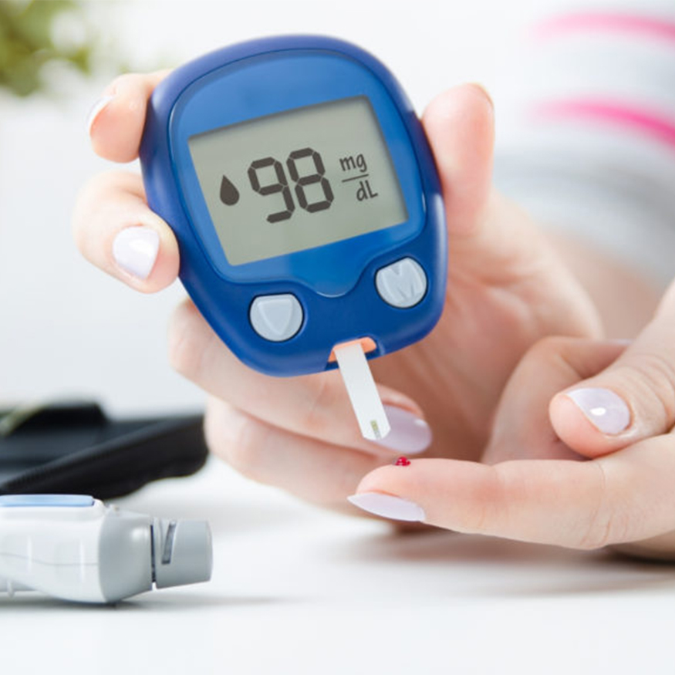
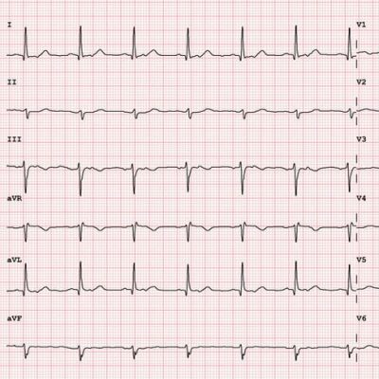

Slide 8
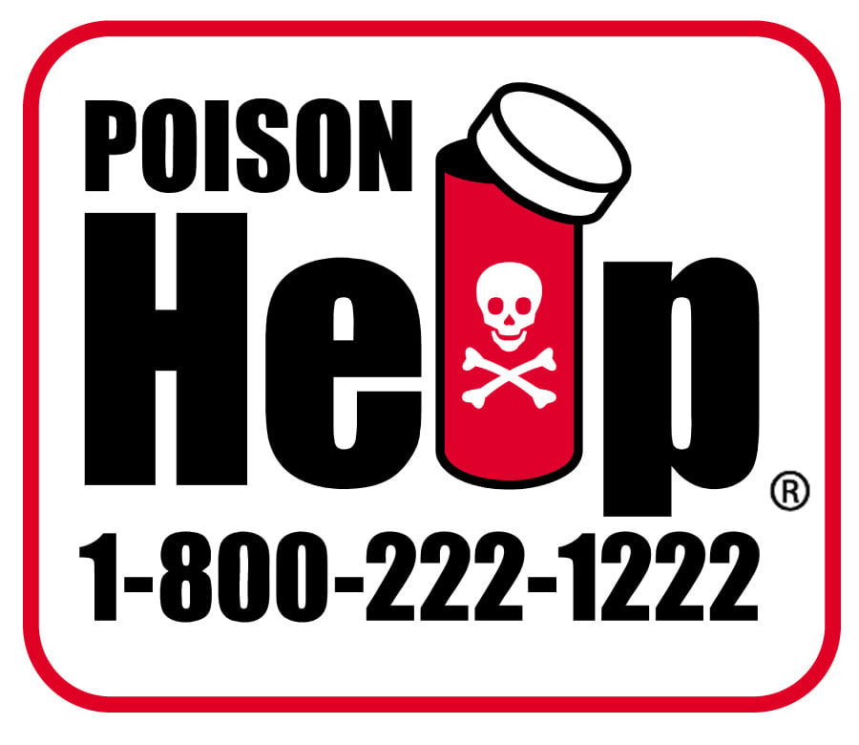

Slide 9
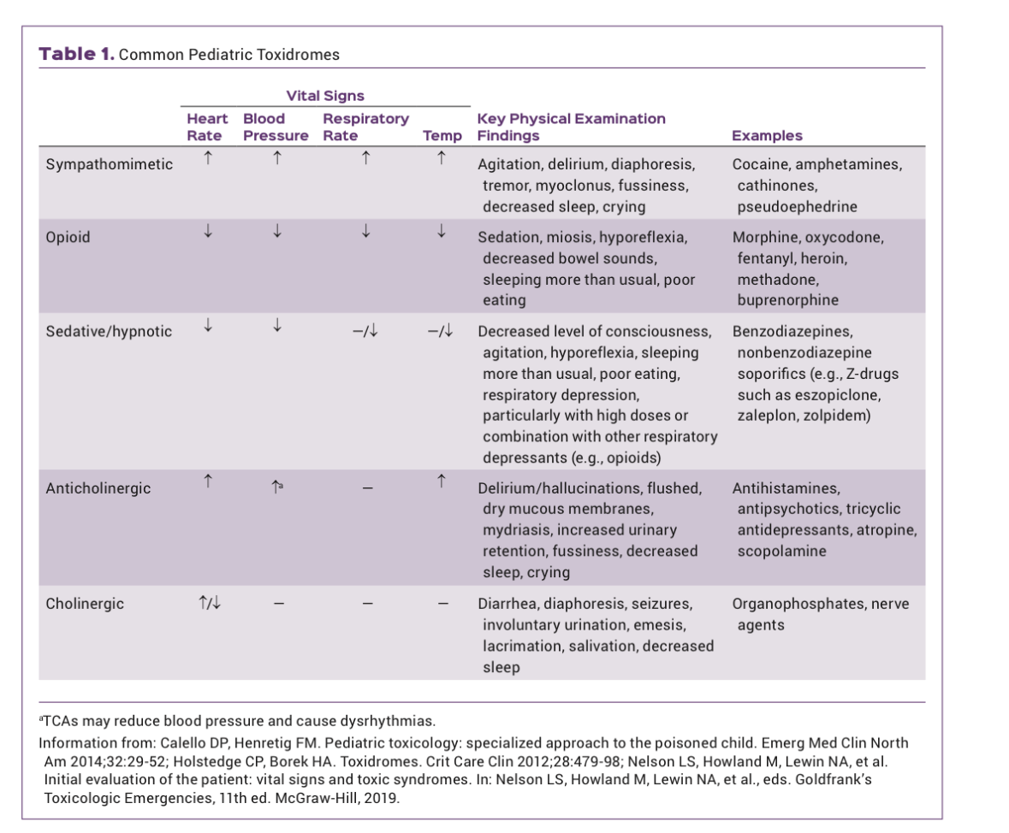
Toxidromes

Slide 10


Slide 11
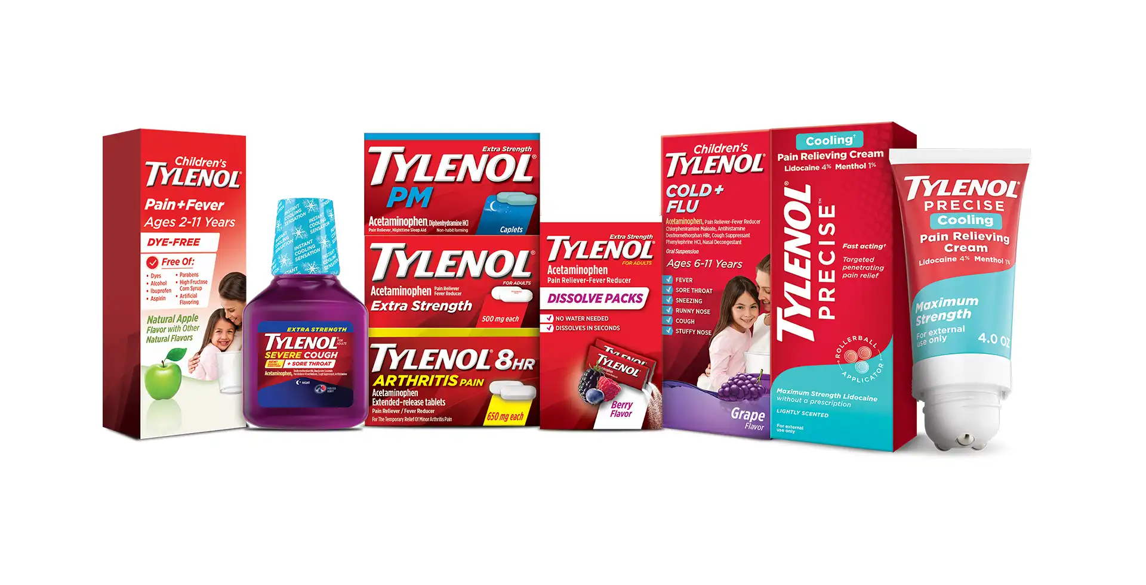
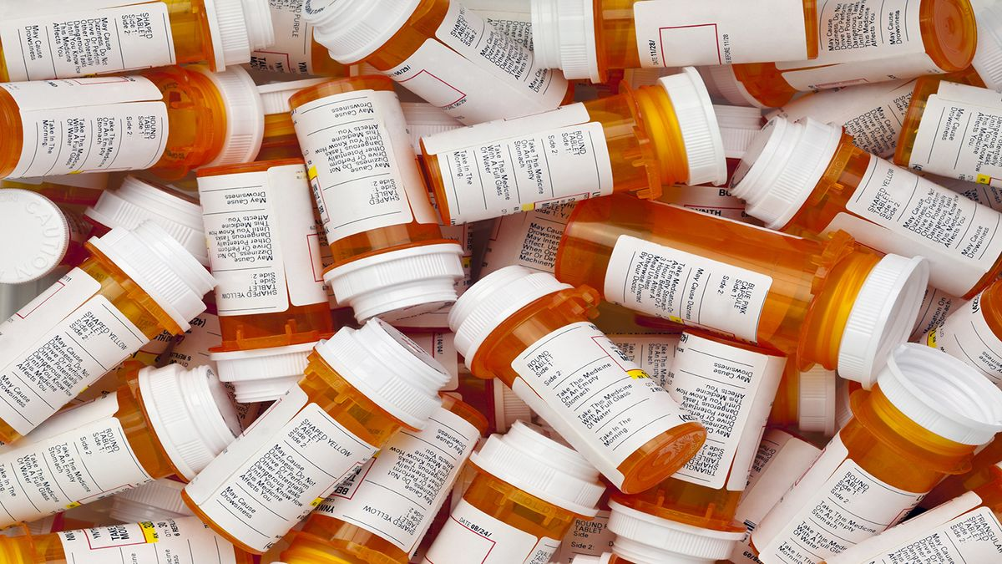

Slide 12
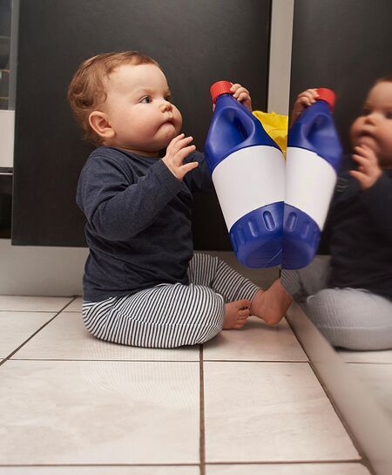
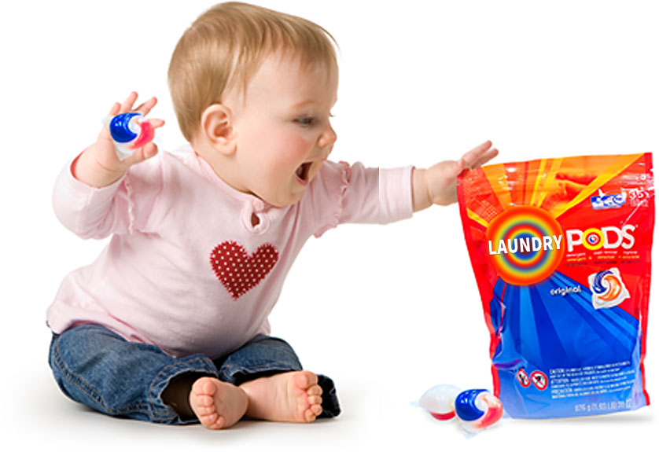

Slide 13
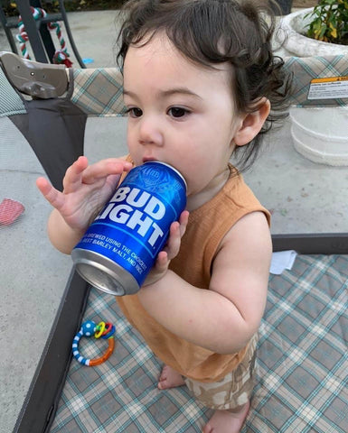

Slide 14
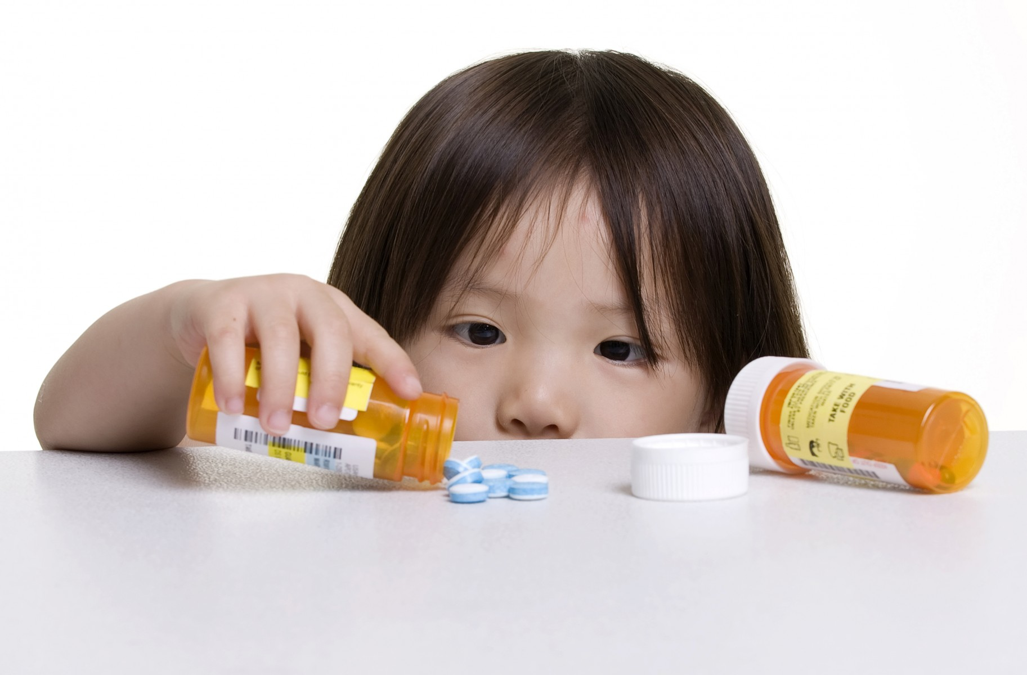
“One pill can kill”

Slide 15
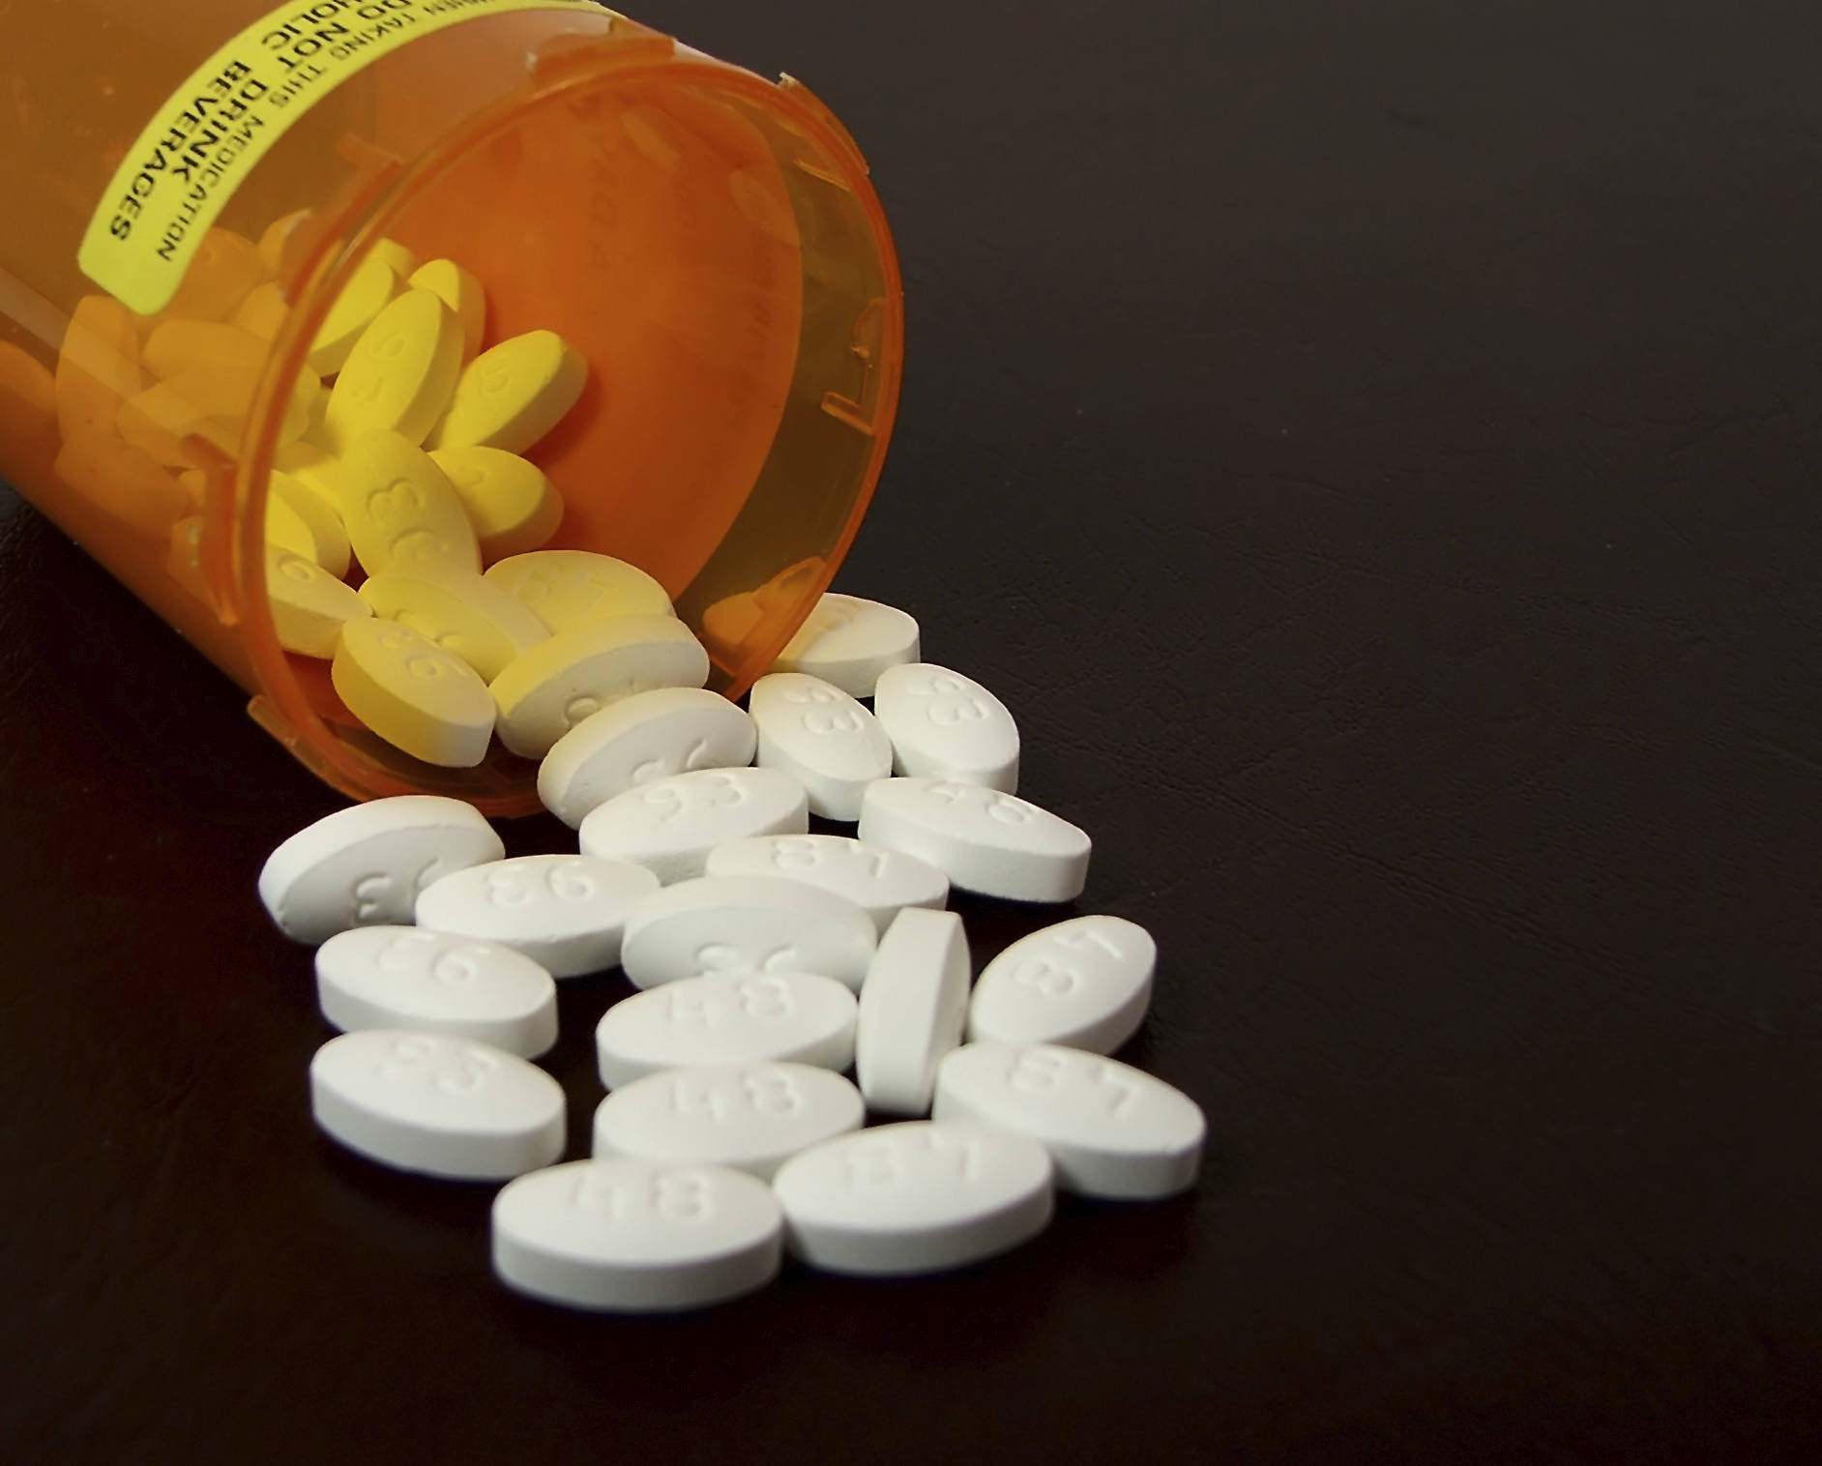
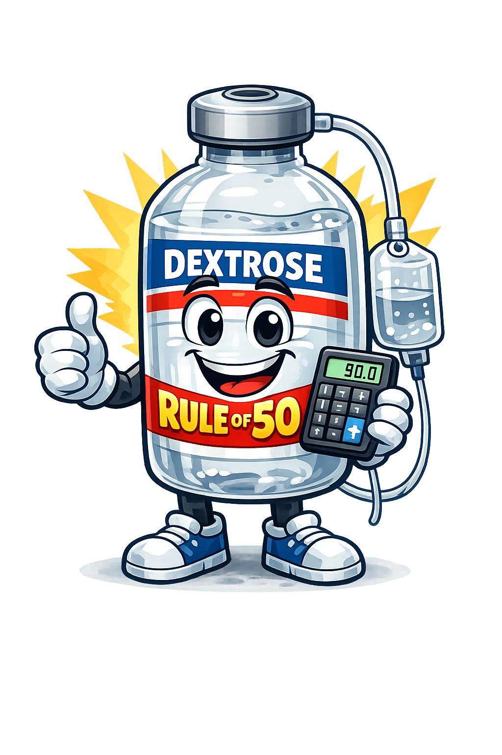
Sulfonylureas
Hypoglycemia
  Irritable, lethargic, abnormal behaviors
  Seizures, coma
Treatment: Dextrose containing fluids, octreotide, glucagon
Charcoal if <2 hours

Slide 16

Beta blockers
Hypotension, bradycardia, dysrhythmias, seizure, hypoglycemia, hyperkalemia
Fluids, atropine
IV glucagon, IV calcium salt, vasopressor, IV high dose insulin and dextrose, IV methylene blue, and IV lipid emulsion therapy

Slide 17
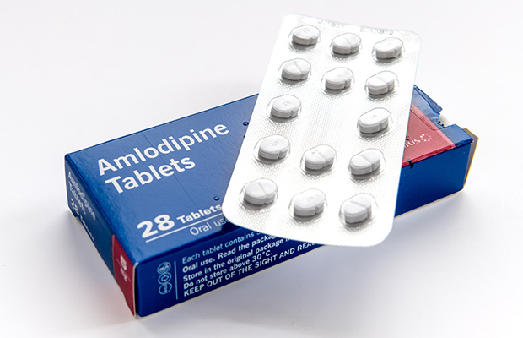
Calcium channel blockers
Similar to beta blockers – hypotension and bradycardia
  But hyperglycemia
  Can maintain mentation even with profound hypotension
Fluids, calcium, glucagon, insulin + glucose, vasopressors, methylene blue, lipid emulsion

Slide 18
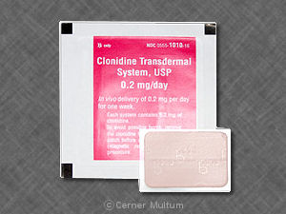
Clonidine
Depressed mental status, miosis, depressed respirations, bradycardia, and hypotension
Naloxone can be tried
Symptomatic care with fluids, pressors, intubation, etc.

Slide 19
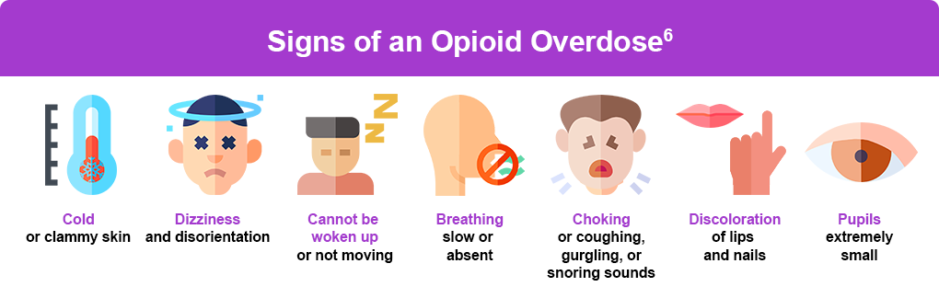
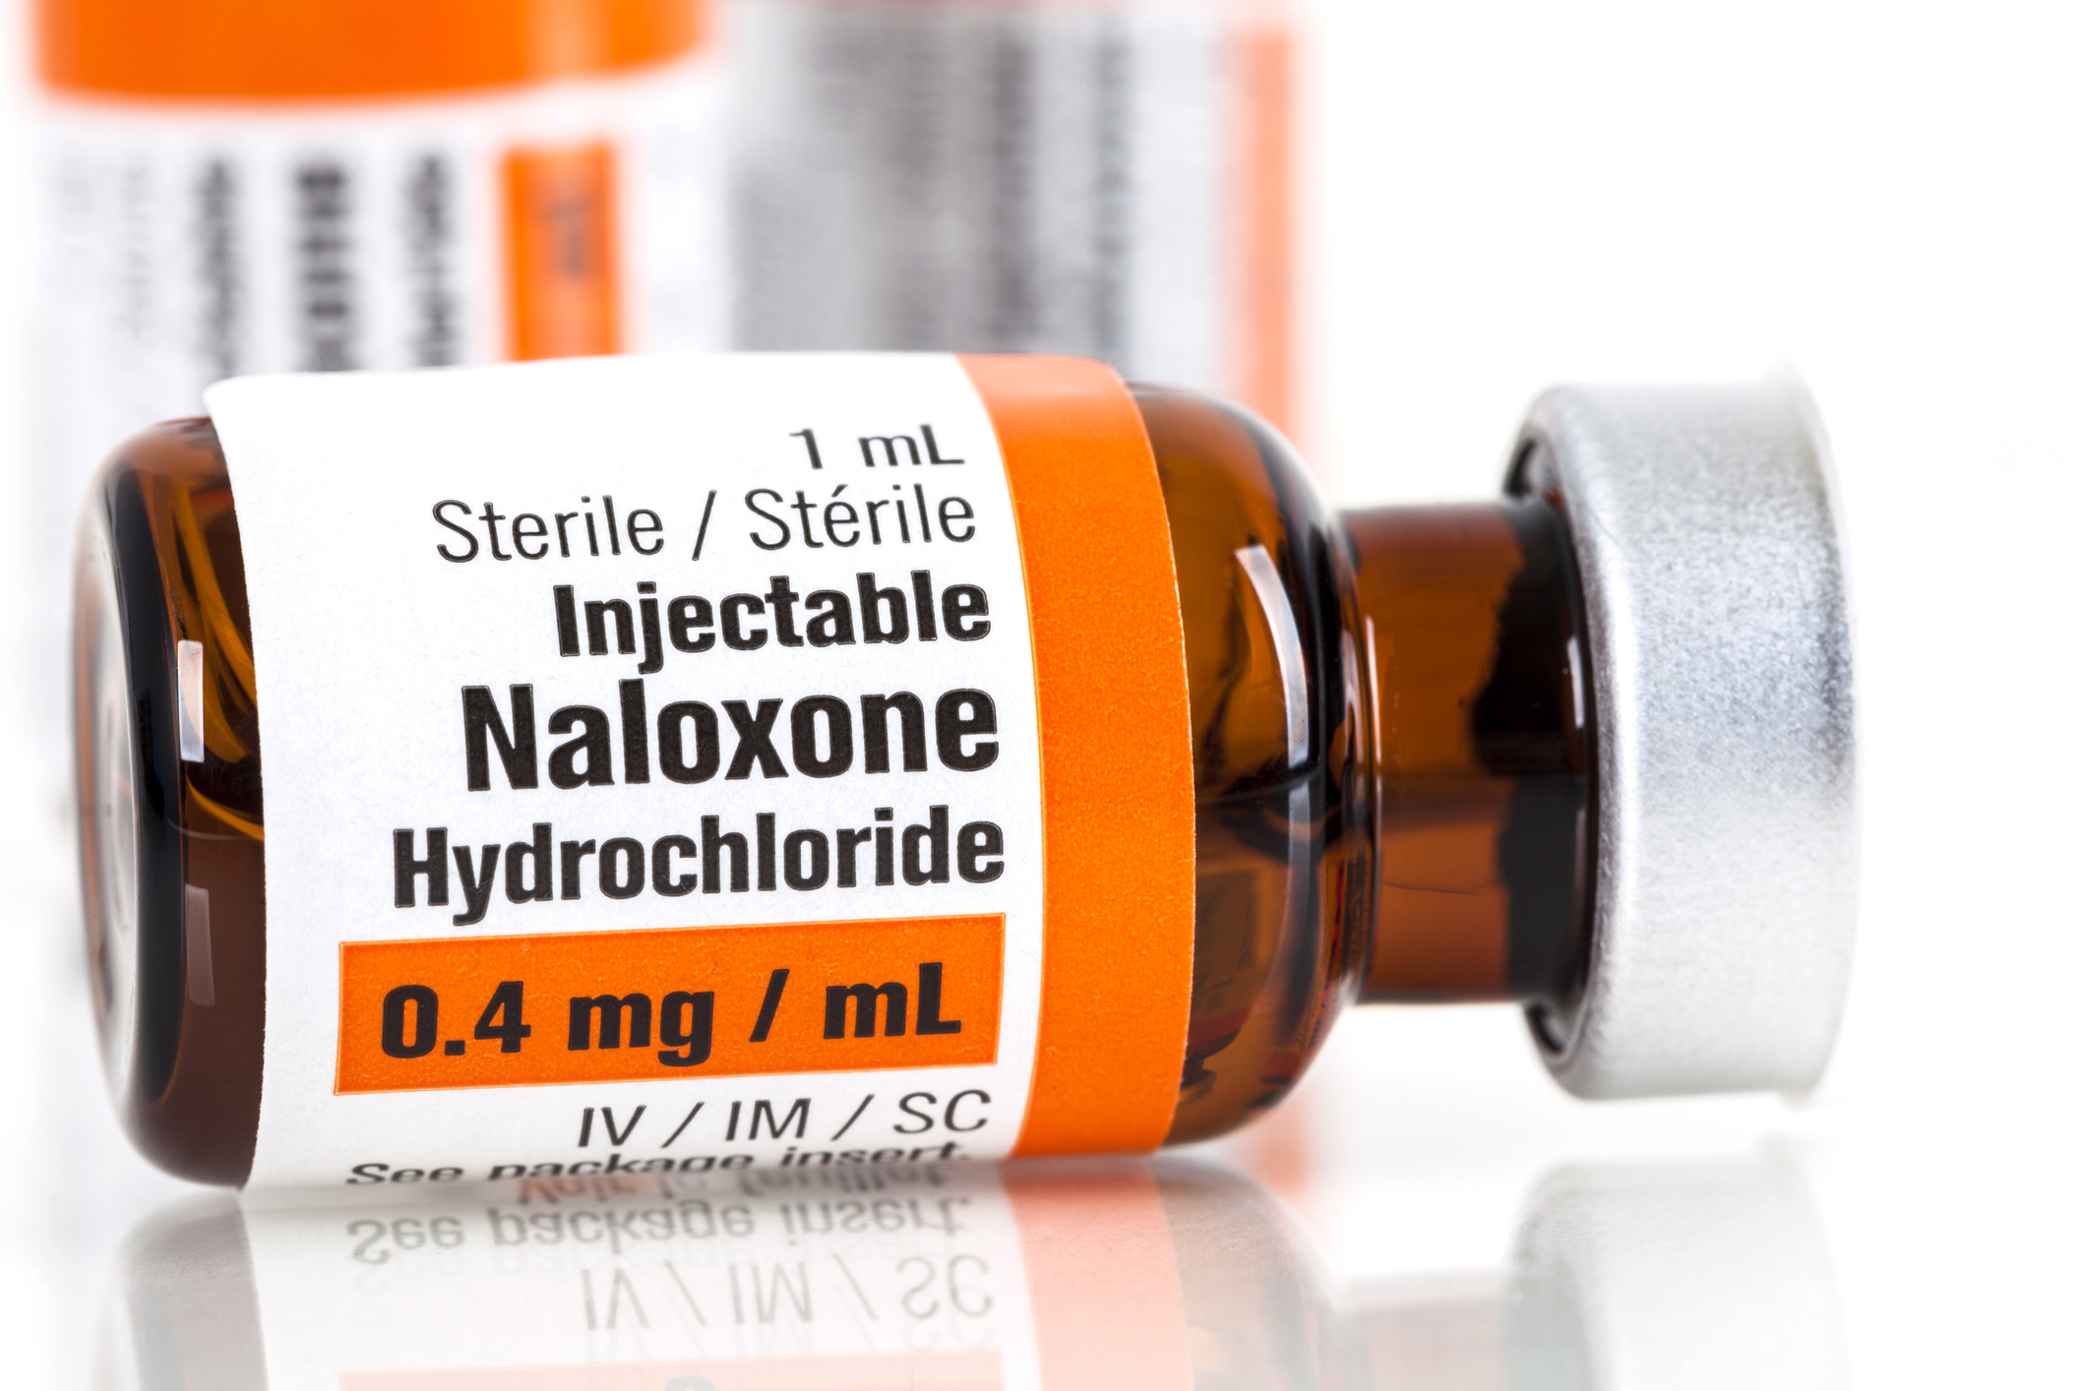

Opioids

Slide 20
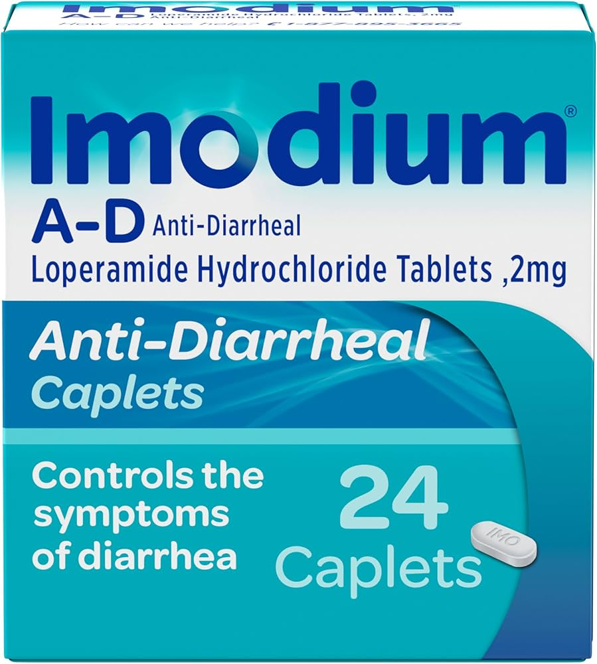
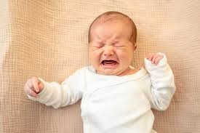

Slide 21
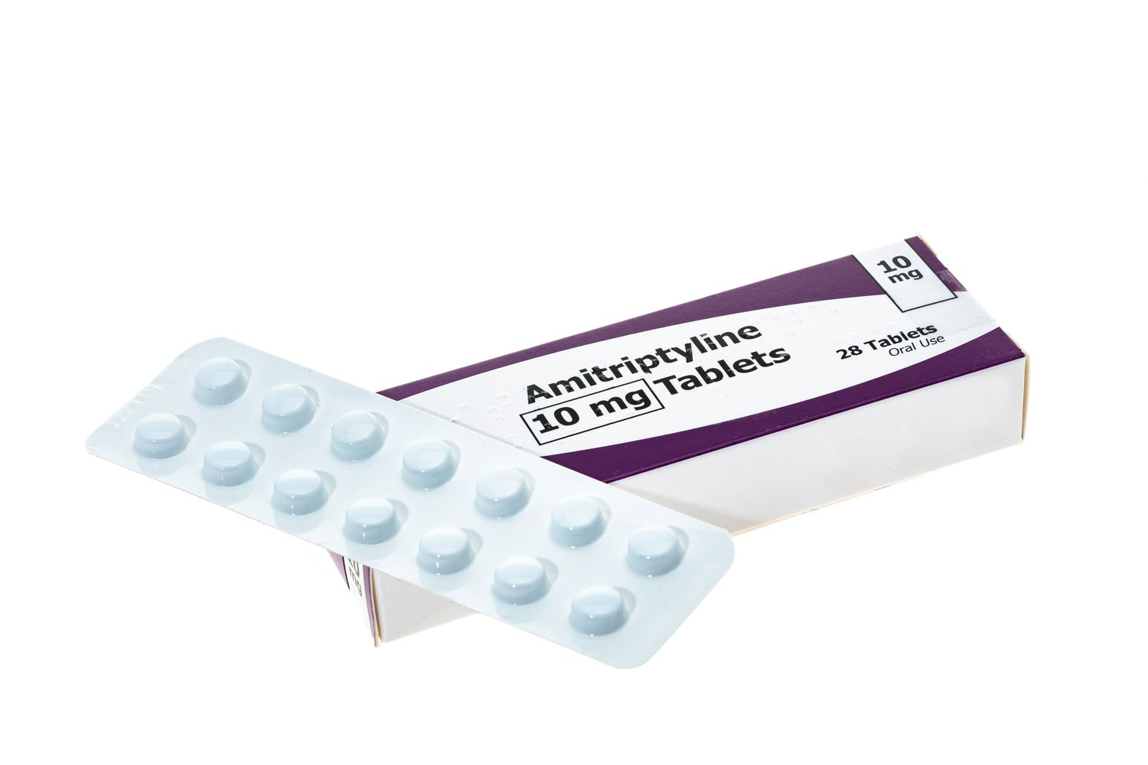
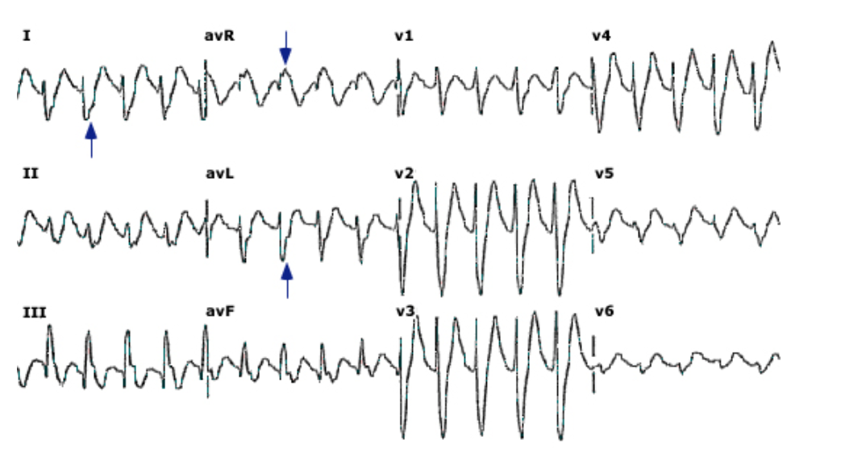
Tricyclic antidepressants
Confusion, AMS, seizures, arrhythmias, hypotension
Sodium bicarb for QRS >100, arrhythmias
Benzos for seizures or agitation

Slide 22
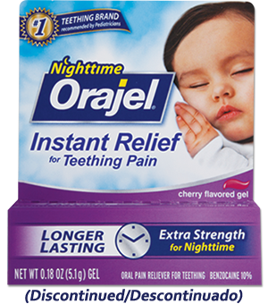

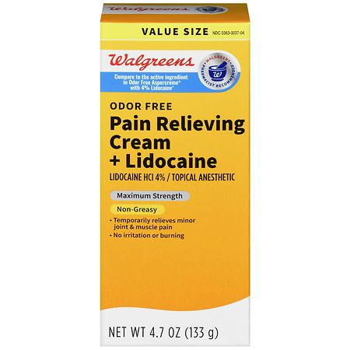
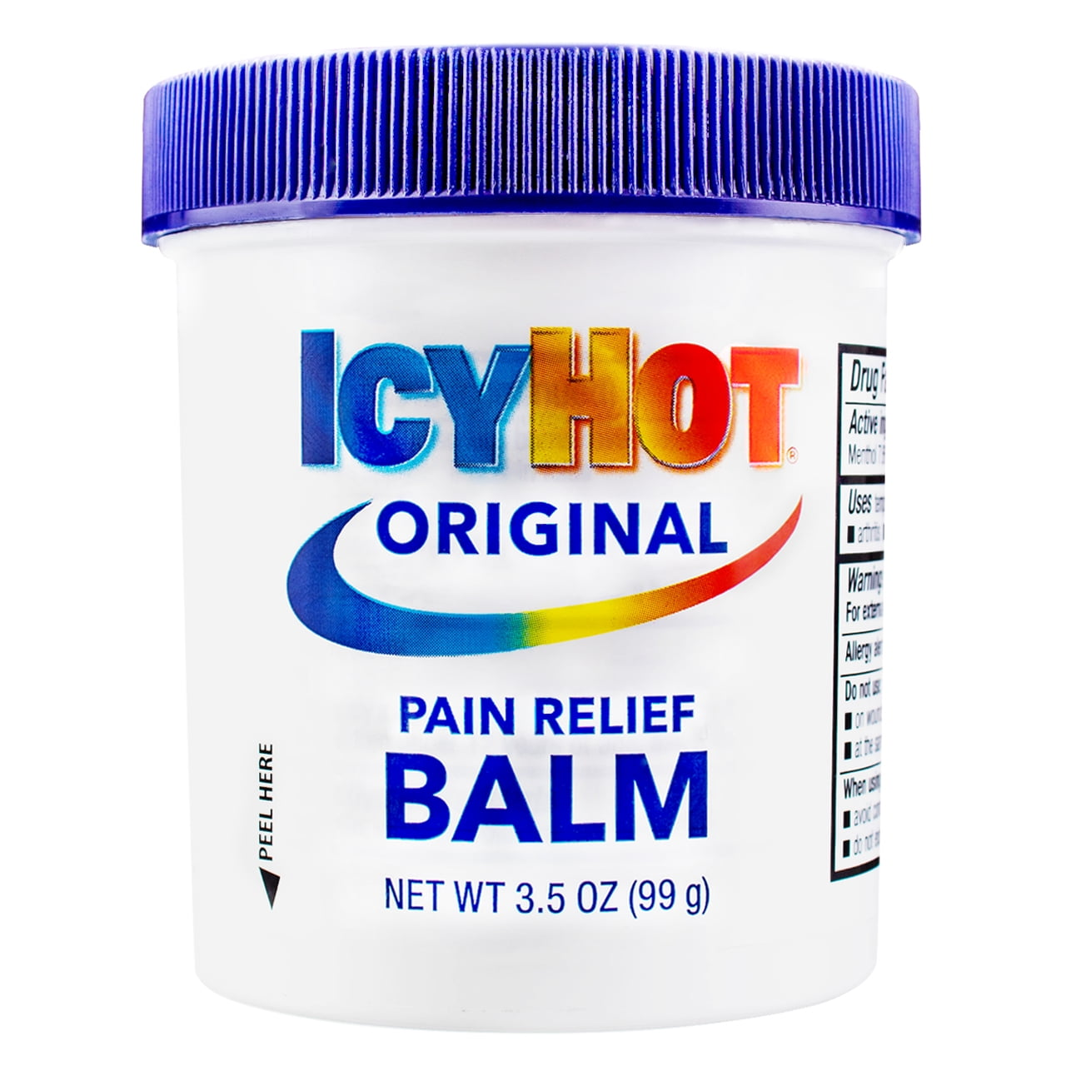
Topicals

Slide 23
Other 1 pill can kill
Theophylline
Antimalarials

Slide 24
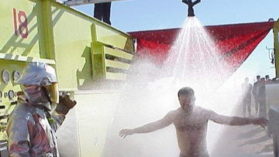

Decontamination

Slide 25
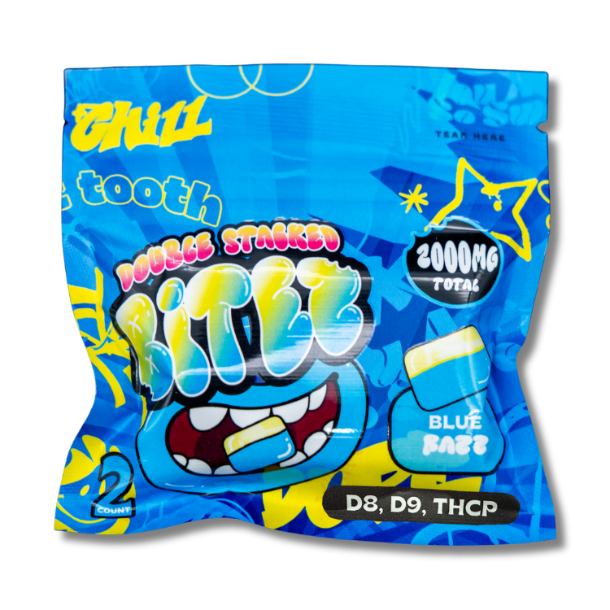

Slide 26
February 2026

Slide 28
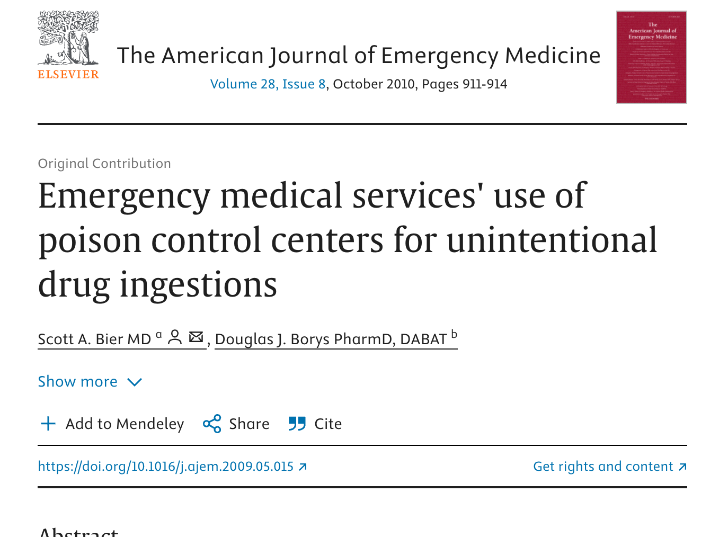

Slide 29
References
Bier SA, Borys DJ. Emergency Medical Services' Use of Poison Control Centers for Unintentional Drug Ingestions. The American Journal of Emergency Medicine. 2010;28(8):911-4. PMID: 20825923
Owusu-Ansah S, Moore B, Shah MI, et al. Pediatric Readiness in Emergency Medical Services Systems. Pediatrics. 2020;145(1):e20193308. PMID: 31857378
Shannon M. Ingestion of Toxic Substances by Children. N Engl J Med. 2000;342(3):186-191. doi:10.1056/NEJM200001203420307
Vega IL, Griswold MK, Laskey D. Am Fam Physician. 2024;109(2):143-153
Pediatric Toxicology.Ross JA, Eldridge DL.Emerg Med Clin North Am. 2022 May;40(2):237-250. doi: 10.1016/j.emc.2022.01.004. Epub 2022 Apr 5.

