Slide 1
OnCore ePRMS Instructions for Reviewers: Initial Review
August 2024

Slide 2
OnCore Account
Contact oncore-support@bcm.edu to get an account or to re-activate your account.
OnCore URL: https://oncore.research.bcm.edu/
Username: your full BCM email (e.g., jdoe@bcm.edu)
Password: your BCM password

Slide 3
Notification of Reviewer Assignment
You will receive a “PRMC Reviewer Assignment” email when you have been assigned to be a reviewer.
Add OnCore to your “safe senders” list
Full reviews: Complete your review before the assigned meeting date.
Expedited reviews: Complete your review within 7 days of being assigned.

Slide 4
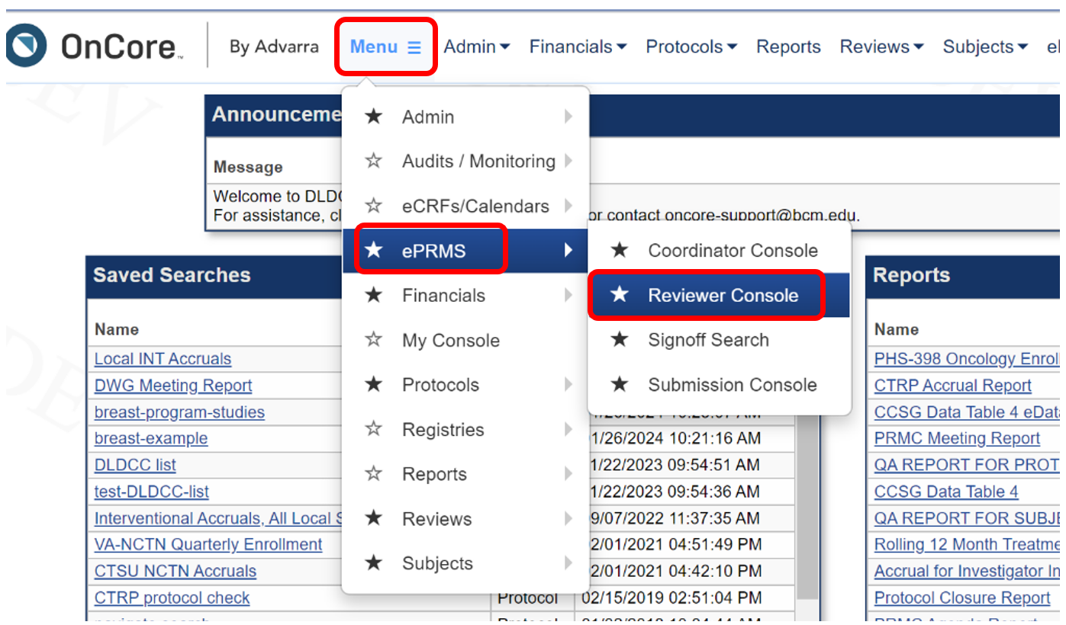
Navigating to ePRMS in OnCore
Along the top menu bar: Menu > ePRMS > Reviewer Console
Note: Your User account may have fewer menu options than shown above.

Slide 5
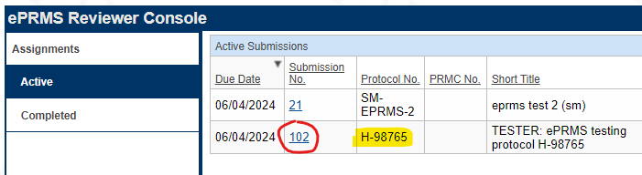
Finding Assigned Protocols
Along the left side, click Active and find the assigned protocol.
Click the Submission No. link to view the protocol.
Under Documents, the protocol and Score Sheet will be attached.
Other information about the protocol is below the documents.

Slide 6
Requirements for Submission
The submission will be reviewed and verified by the PRMC Coordinator before the study is assigned.
At a minimum, these documents should be attached:
Protocol
Completed DWG/Program Score Sheet
Data and safety monitoring plan (if not part of the protocol document)
PRMC approval from the Lead Site, if the study is “relying” on external PRMC review

Slide 7
Conducting Protocol Review
Review the submitted documents.
Complete the PRMC Reviewer Checklist.
Available at: https://www.bcm.edu/academic-centers/dan-l-duncan-comprehensive-cancer-center/research/clinical-research/protocol-review-and-monitoring-committee
Select the checklist for Full or Expedited review.
If you have questions or modifications to go back to the PI, please clearly state those in your checklist.
Save your completed Checklist as a document on your computer.

Slide 8
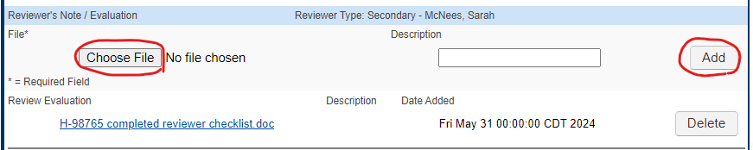
Reporting your review
Attached your completed Checklist under Reviewer’s Note / Evaluation:
Choose File: select the completed checklist that you have saved
Description: optional
Click Add.
Your document will now be attached.
If you attached the wrong document, click Delete, and repeat the steps above.

Slide 9
Query Workflow
If there are questions for the PI, the PRMC Coordinator will send those to the PI/Submitter in ePRMS.
The PI/Submitter will submit their responses in ePRMS.
The PRMC Coordinator will email the responses to the assigned reviewer(s) for review.
If the responses are approved, or if there are additional questions, the Coordinator will process that decision in ePRMS.

Slide 10
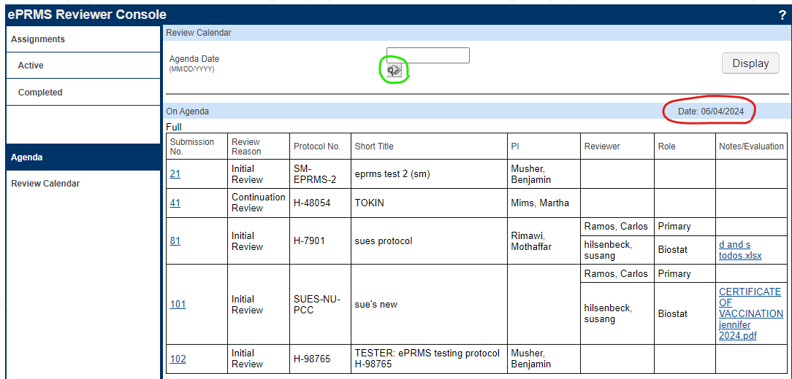
Viewing a Meeting Agenda
You can view any protocol submitted to ePRMS, even if you are not an assigned reviewer.
From the Reviewer Console, click Agenda on the left side.
The console will display the agenda for the next scheduled meeting (red circle).
You will see all items assigned to that meeting. Click on the Submission No. link to view a protocol, including attachments.
To view a different meeting date, use the search for Agenda Date at the top (green circle).

Slide 11
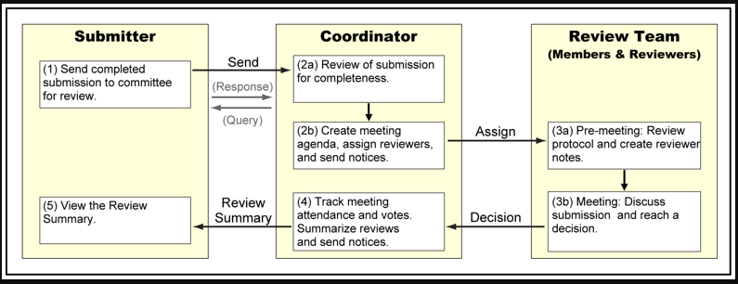
ePRMS Full Review Process

Slide 12
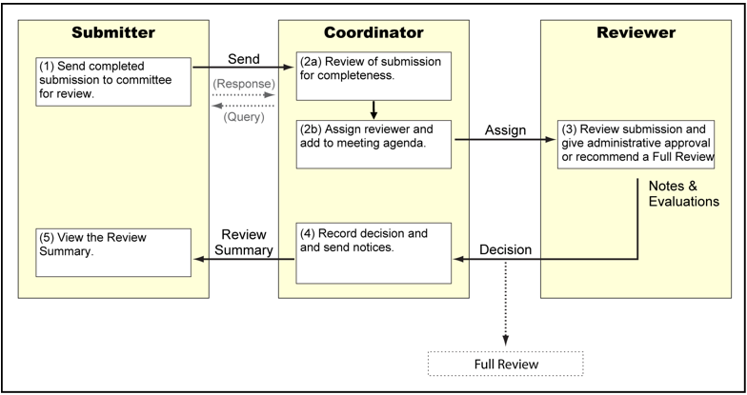
ePRMS Expedited Review Process

Slide 13
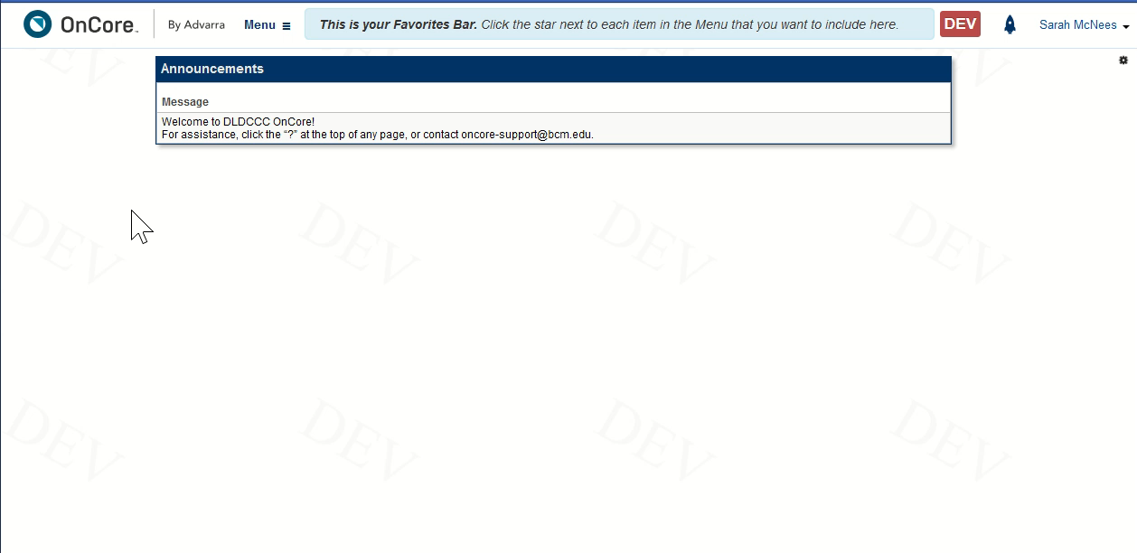
Brief Demonstration

